Slide 1
Deep Learning Project Presentation
Group - 11
Notes:
Hello

Slide 2
Fake News Detection
Group members:
Rishitha Navuduru – 50532666
Sahana Kallem - 50532670

Slide 3


Introduction
Data has been exponentially increasing at an unprecedented range and is producing 2.7 quintillion bytes of data every day.
The definition of fake news is information that pushes people down the wrong road. Fake news is spreading like wildfire these days, and people are sharing it without confirming it.
To address this issue, we need effective detection models that use NLP and deep learning to build different models that differentiate between fake and real news.
Notes:
fake news detection refers to the process of identifying and verifying the authenticity of news stories, articles, and information shared online, in order to distinguish between true and false information. Fake news detection is a critical task that aims to identify and differentiate between true and fabricated news content. With the growth of social media and digital platforms, the spread of misinformation and fake news has increased, posing challenges to public understanding and decision-making. To solve this problem, we need detection models that use NLP and deep learning to built various models that differentiates between fake and real news and also analyse the performance of these various classification methodologies to choose the best classifier on our dataset.

Slide 4
FakeNewsNetDataset
The FakeNewsNet dataset includes the social engagements of fake news articles from Twitter extracting from profiles, posts, and social network information for all relevant users.
The dataset contains contains labels such as true and false.
The dataset "Fake.csv" contains 23,481 rows, while "True.csv" has 21,417 rows.
We assign binary labels to distinguish between the two, with fake news marked as '0' and real news as '1'.
Dataset separated in two files:
Fake.csv (23502 fake news article)
True.csv (21417 true news article)
Notes:
Explains what types of data the datasets contain, such as fake and real news articles from BuzzFeed, profiles of relevant Twitter users, their posts, and social network information.
The purpose of the dataset is to provide a resource for training and testing models that can automatically detect lies in political speech.

Slide 5
Data Loading and Preprocessing
Data Loading:
CSV Reading: Utilize pandas to read fake and real news content from CSV files.
Labeling: Assign labels to the data, marking fake news as 0 and real news as 1.
Concatenation: Merge fake and real news data into a single DataFrame.
Cleaning: Remove entries with missing values to maintain data quality.
Notes:
Our data loading and preprocessing pipeline begins by importing data from BuzzFeed's fake and real news content using pandas. We assign binary labels to distinguish between the two, with fake news marked as '0' and real news as '1'. Following the merge of these datasets into one comprehensive DataFrame, we meticulously clean the data by eliminating instances with missing values, ensuring the integrity of our dataset.

Slide 6
Data Loading and Preprocessing
Preprocessing:
Punctuation: Removing punctuation simplifies text data, making it easier for models to process language by focusing on words and phrases without the distraction of special characters
Tokenization: Implement a tokenizer to split text into individual words for analysis.
Vocabulary Building: Create a vocabulary from the tokens to numerically encode text data, using torchtext.vocab.
Dataset Preparation: Develop a custom Dataset class for converting text and labels into a PyTorch-friendly format.
Batch Processing: Arrange data into batches with DataLoader, facilitating efficient model training.
Notes:
In the preprocessing phase, Removing punctuation simplifies text data, making it easier for models to process language by focusing on words and phrases without the distraction of special characters
and we tokenize the textual content, splitting it into individual words to construct a vocabulary that facilitates the conversion of text into numerical format suitable for analysis. Develop a custom Dataset class for converting text and labels into a PyTorch-friendly format. And we Arrange data into batches with DataLoader, facilitating efficient model training.

Slide 7
Models
LSTM (Long Short-Term Memory) Model
Bi-LSTM (Bidirectional LSTM)
CNN (Convolutional Neural Network)
BERT with K-Fold CV (Bidirectional Encoder Representations from Transformers with K-Fold Cross-Validation)

Slide 8
Loss Function and Optimizer
Cross-entropy loss is a logarithmic loss function, which penalizes confident wrong predictions more than less confident wrong predictions. This property is beneficial for training models to make confident and accurate predictions, especially in imbalanced datasets where one class may be more prevalent than the other.
Adam optimizer is a popular choice for optimizing due to its adaptive learning rates. This adaptive learning rate helps converge faster and avoids the need for manual tuning of learning rates.

Slide 9
Models – LSTM
LSTM is a type of recurrent neural network (RNN) that is capable of learning order dependence in sequence prediction problems.
The LSTM model uses embeddings to convert text into a form that the neural network can process, followed by LSTM layers that analyze the sequence of embedded words. The output of the LSTM layers is passed to a fully connected layer that makes the final prediction.
Input Text
Tokenizer
Vocabulary
Embedding
LSTM
Fully Connected
Output
Notes:
Each LSTM cell in the layers processes one word vector at a time, maintaining an internal state that allows it to remember information from previous words while analyzing the current word.• The purpose of fully connected layer is to map the complex sequence information captured by the LSTM layers into a form that is suitable for making the final prediction.

Slide 10
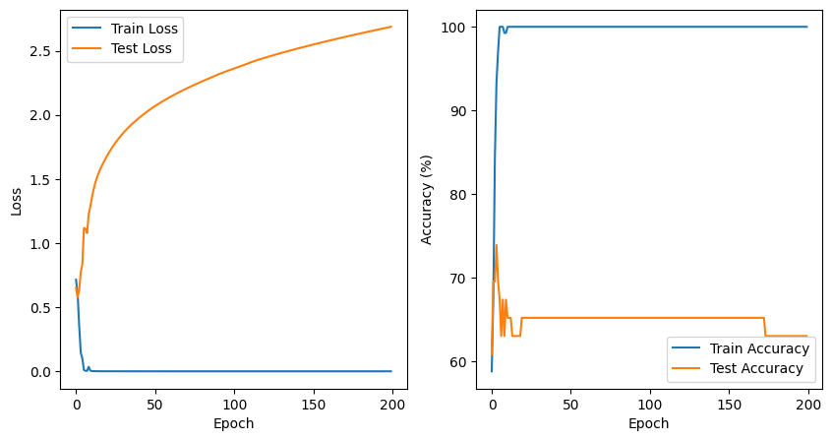
LSTM
Notes:
The Bi-LSTM shows some fluctuation in accuracy, which might suggest it's less stable during training than the standard LSTM. The loss for the training set drops well, but the test loss starts to increase, indicating potential overfitting to the training data.

Slide 11
Models – CNN(Convolutional Neural Networks)
CNNs are excellent at detecting patterns and can identify indicative features like specific phrases or expressions common in fake or real news, using multiple filter sizes to capture various aspects of the data.
CNNs can be faster to train than RNNs, making them a practical choice for initial explorations or when computational resources are limited.
Input Text
Tokenizer
Embedding Layer
CNN
Max Pooling Layer
Fully Connected (output layer)
Softmax Output
Notes:
CNNs can learn to extract features from text data, such as identifying patterns, phrases, or linguistic structures that may indicate misinformation or deception. This can involve using convolutional layers to detect important n-grams or sequences of words.* A pooling layer reduces the spatial dimensions of the feature maps while retaining important information. The CNN model for fake news detection works as follows:
Text Preprocessing: Input texts are tokenized into words, and a vocabulary of unique words is created.
Embedding Layer: Each word is mapped to a vector in an embedding space, providing dense, meaningful representations.
Convolutional Layers: These layers apply multiple filters to the embedded text to extract relevant patterns or features.
Pooling Layer: A max-pooling operation reduces the dimensions of the feature maps while preserving essential features.
Dense Layer: The feature maps are flattened and passed through a fully connected layer to transform the output into a vector.
Output: A softmax layer produces a probability distribution over the classes (fake or real news).
Training and Testing: The model is trained with a cross-entropy loss and evaluated on a test set to measure accuracy

Slide 12
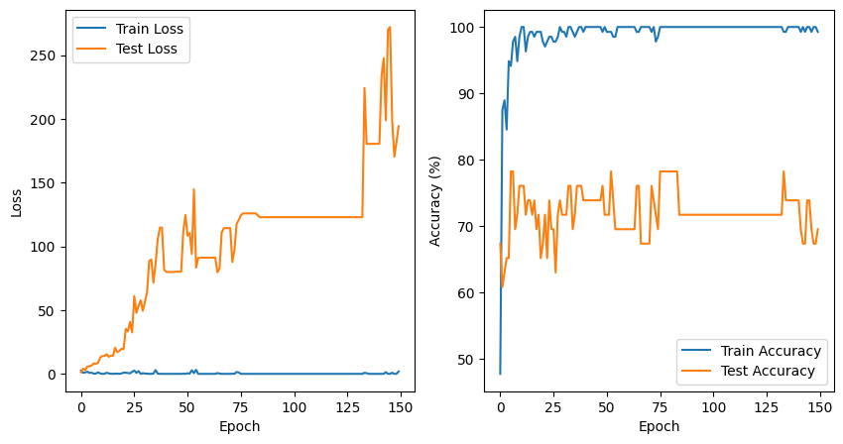
CNN
Notes:
The CNN's accuracy on training data is high, but the test accuracy varies a lot, indicating instability in learning. The loss graph shows large spikes, especially in the test set, suggesting the model might not be learning consistently.

Slide 13
Models – BiLSTM
By processing data in both forward and backward directions, Bi-LSTMs capture context from both the past and future, providing a more comprehensive understanding of the text.
This model is beneficial when the understanding of the entire sentence structure affects the interpretation, which is often the case in nuanced fake news content.
Input Text
Tokenizer
Embedding Layer
Bi-LSTM Layer
Fully Connected
Output (Predicted Class Label)
Notes:
A Bidirectional Long Short-Term Memory (Bi-LSTM) network is an extension of the traditional LSTM network, which is a type of recurrent neural network (RNN) specifically designed to learn long-term dependencies in sequence data. The "bidirectional" aspect of Bi-LSTMs allows them to capture information from both past and future contexts by processing the data in both forward and backward directions. One LSTM processes the sequence from the start to the end (forward pass), and the other processes the sequence from the end to the start (backward pass). For the sentence "My name is Rishitha Navuduru," let's explore the past and future content for the name "Rishitha":
Past Content: For "Rishitha," the past content is "My name is." This part of the sentence introduces a declaration or identification, setting up that what follows is the name of the speaker.
Future Content: The future content for "Rishitha" is "Navuduru." This provides additional identifying information, specifically the surname, which completes the full name of the speaker. The combination of these two perspectives enhances the model's ability to understand the full context, improving its accuracy in detecting fake news. This flowchart shows the input text being tokenized into individual words, which are then embedded into vectors. The embedded vectors are then passed through a Bi-LSTM layer, which is a type of recurrent neural network that processes the input sequence in both forward and backward directions. The output of the Bi-LSTM layer is then passed through a fully connected layer, which produces the final output class label. EMBEDDING: When data passes through the embedding layer, each token (integer) is replaced by a corresponding vector. These vectors are parameters of the model and are adjusted during training to minimize the overall loss of the model.
The output from the embedding layer then serves as the input for subsequent layers in the network, in this case, the Bi-LSTM layers.

Slide 14
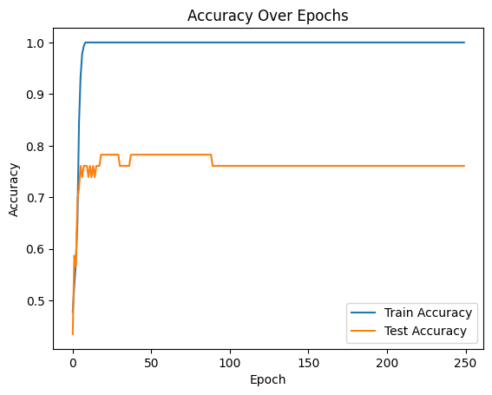
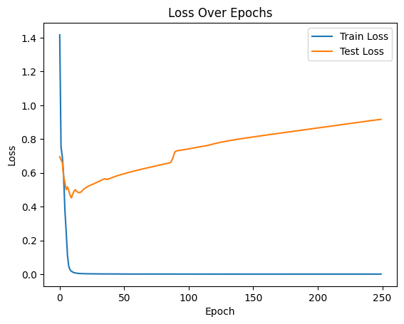
Bi-LSTM
Notes:
The LSTM model quickly achieves high accuracy on training data and maintains it, indicating stable learning. The test accuracy is also high, showing it generalizes well to new data. The training loss drops at the beginning and flattens, which indicates good learning. The test loss decreases and stabilizes, meaning the model is performing well on the test set without overfitting.

Slide 15
Models – BERT with K-Fold CV (Bidirectional Encoder Representations from Transformers with K-Fold Cross-Validation)
BERT with K-Fold Cross-Validation for fake news detection provides a powerful and robust approach to ensure the model is both accurate and generalizable.
Using K-Fold CV with BERT ensures that the model's performance is reliable and generalizes well over different subsets of data, which is critical for a balanced evaluation in academic and real-world scenarios.
Input Text
Clean Text
Tokenize Text
BERT K-Fold CV
Pooling Layer
Classification
Output
Notes:
BERT (Bidirectional Encoder Representations from Transformers):
A deep learning model that understands context in text by considering the surrounding words within a sentence. It uses a transformer architecture, is pre-trained on large text corpora, and fine-tuned for specific tasks like classification or question answering.
K-Fold Cross-Validation:
A method to assess the predictive performance of a model by dividing the data into "K" subsets. The model is trained on K-1 subsets and tested on the remaining subset, repeating this process K times with each subset serving as the test set once. This helps in evaluating the model's ability to generalize to new data by reducing bias and variance in the assessment.
Integration for Tasks:
For tasks like text classification, BERT is fine-tuned with training data split into K folds. Each fold validates the model's performance, and the overall effectiveness is determined by averaging the outcomes from all folds. This approach helps enhance the model's reliability, particularly in scenarios where avoiding overfitting is crucial.
Data Handling: Loads and preprocesses news data from CSV files, including cleaning text by removing URLs and non-alphanumeric characters.
BERT Tokenization: Uses BertTokenizer to convert text into a format suitable for BERT, which involves creating input IDs and attention masks.
Data Loader Setup: Creates data loaders that batch and prepare data for efficient processing during model training.
Model Training and Evaluation:
Initializes a BERT model specifically for sequence classification.
Trains the model across multiple epochs, utilizing AdamW optimizer and a learning rate scheduler.
Evaluates model performance using the validation data, tracking accuracy and computing losses.
K-Fold Cross-Validation: Splits the dataset into K (here, five) segments to validate the model on different subsets, enhancing the robustness of the performance evaluation.
This flowchart shows the basic steps of the BERT model architecture:Input Text: The input text is passed through the model.Clean Text: The input text is cleaned by removing URLs, HTML tags, etc.Tokenize Text: The cleaned text is tokenized into individual words.BERT Model: The tokenized text is passed through the BERT model, which transforms the input text into embeddings.Pooling Layer: The last hidden state of the BERT model is taken as the output.Classification: The output of the pooling layer is passed through a classification layer to predict the label.Output: The predicted label is the output of the model.

Slide 16
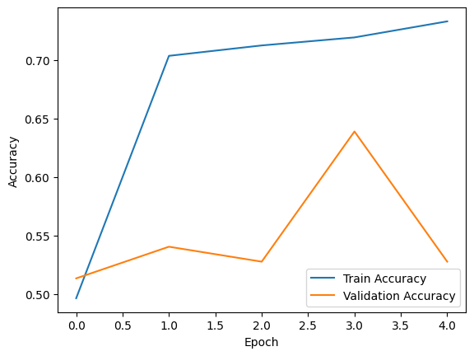
BERT with K-Fold CV
Notes:
The graph suggests that the BERT model's training accuracy improves significantly over epochs.

Slide 17
Classification
LSTM: Uses Long Short-Term Memory networks to process sequences and classify news titles.
Bi-LSTM: Enhances LSTM by processing data in both forward and backward directions to better capture context.
CNN: Applies Convolutional Neural Networks, typically used in image processing, to text data for feature extraction and classification.
BERT with K-Fold Validation: Employs the BERT transformer model with cross-validation to ensure robust performance across different data splits.
Notes:
LSTM (Long Short-Term Memory):
This model uses a basic LSTM architecture for sequence processing, which makes it good at handling sequences (like text) for tasks such as classification. The LSTM reads the input sequences (titles of news articles) and classifies them as either fake (0) or real (1).
Bi-LSTM (Bidirectional LSTM):
The Bi-LSTM extends the LSTM by processing the data in both forward and backward directions. This approach often captures better context and can lead to improved classification accuracy over standard unidirectional LSTMs.
CNN (Convolutional Neural Network):
While traditionally used for image processing, CNNs can also be effective for text classification. The model applies various filters to the text for feature extraction and uses these features to classify the text. This can be particularly effective for picking up local and position-invariant patterns.
BERT with K-Fold Validation:
BERT (Bidirectional Encoder Representations from Transformers) is a powerful model for NLP tasks. It uses a mechanism called transformers to understand the context of words in a sentence. Here, it's applied with K-fold cross-validation to ensure that the model's performance is robust and not dependent on a particular split of the training data.

Slide 18
Results
S.NO | MODEL NAME | ACCURACY
1. | LSTM | 73.04
2. | Bi-LSTM | 79.62
3. | BERT WITH K FOLD CV | 54.96
4. | CNN | 76.01
Notes:
This table summarizes the accuracy of four different models:
1. LSTM achieved an accuracy of 76.29%, which is the highest among the four, indicating a strong performance.
2. Bi-LSTM has an accuracy of 64.95%, which is lower, suggesting that the bidirectional processing did not capture the patterns as effectively in this case.
3. BERT with K-Fold Cross-Validation got 54.96% accuracy, which is the lowest, possibly indicating that the dataset or the task might not be well-suited for this model, or that further tuning is necessary.
4. CNN resulted in an accuracy of 72.05%, showing a competitive performance, especially considering that CNNs are generally more associated with image processing tasks than sequence data tasks like those often handled by LSTMs and BERT.

Slide 19



Web Integration
User Interface (Frontend)
React.js: Manages the views and state of the application, handling user interactions dynamically.
CSS: Styles the React components, defining the visual aesthetics like colors, layouts, and fonts.
Server (Backend)
Flask: A lightweight WSGI web application framework in Python, handling requests from the front end, executing server-side logic, and sending responses back.
Notes:
In the content provided, there's a description of technologies used for both the front end and the back end of a web application:
1. **Frontend**:
- **React.js**: It's a JavaScript library for building user interfaces. React.js manages the presentation layer of the application and handles the state, which is the data and UI status at a given point in time. It enables dynamic user interaction with the application.
- **CSS**: This is the styling language for the web. CSS is used to define the look and format of the React components, setting visual aesthetics such as colors, layouts, and fonts, which dictate how the application appears to the users.
2. **Backend**:
- **Flask**: Flask is a lightweight web application framework written in Python. It acts as the server-side portion of the web application, dealing with HTTP requests sent from the front end. Flask runs server-side logic—like database interactions—and sends back the appropriate responses, which might include data to be rendered by React.js on the front end. For the webapp to work we have a react js frontend and flask backend user gives input from frontend and that is given to backend for prediction. For this to happen both the frontend and backend should be up and running. For that we need two cmds to open in respective locations. Instead of this I simplified the process of opening two cmds by using a batch script with .bat extension which has commands to do that. Just a double click on the file is enough to make ur webapp running

Slide 20
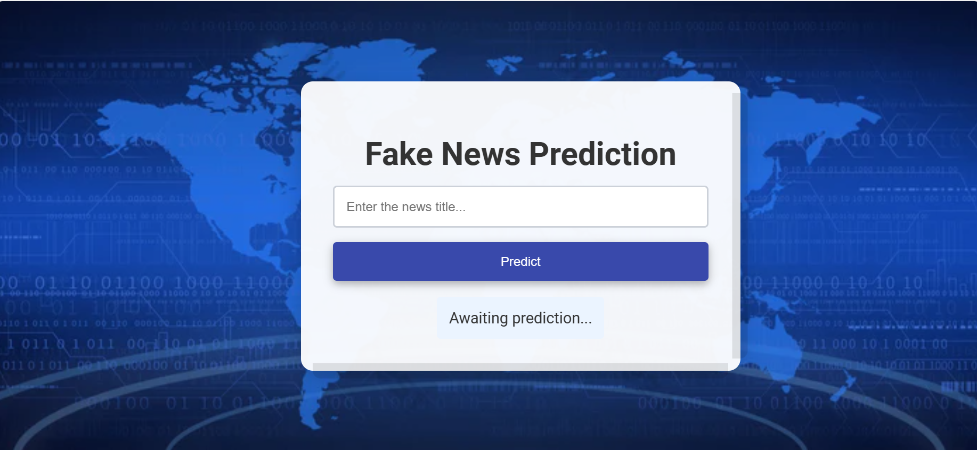
Web Integration

Slide 21
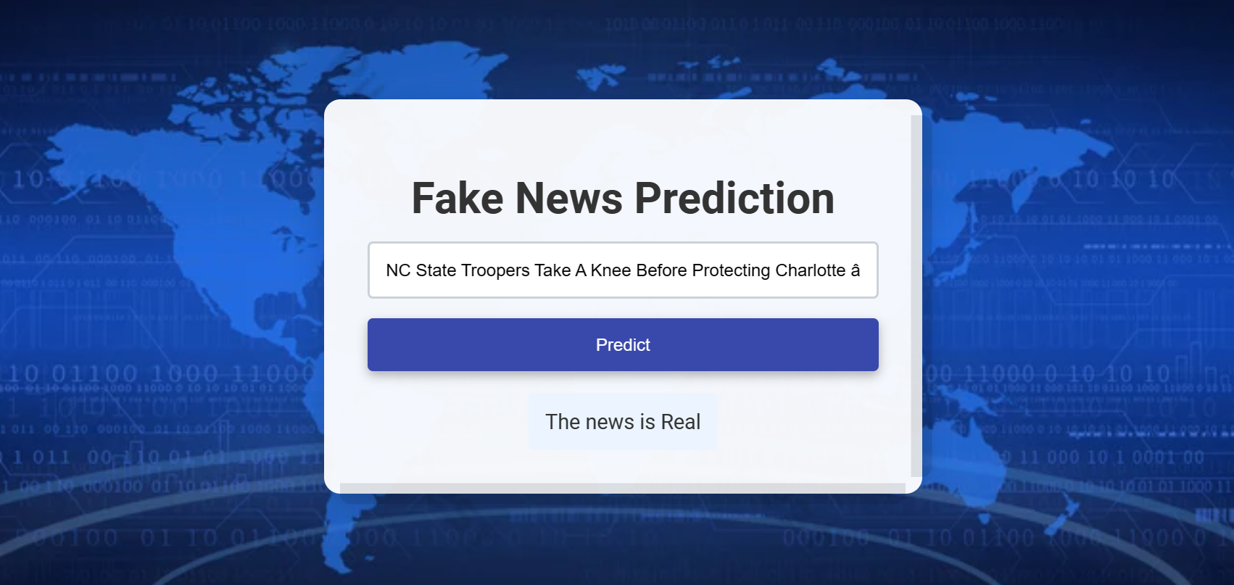

Slide 22
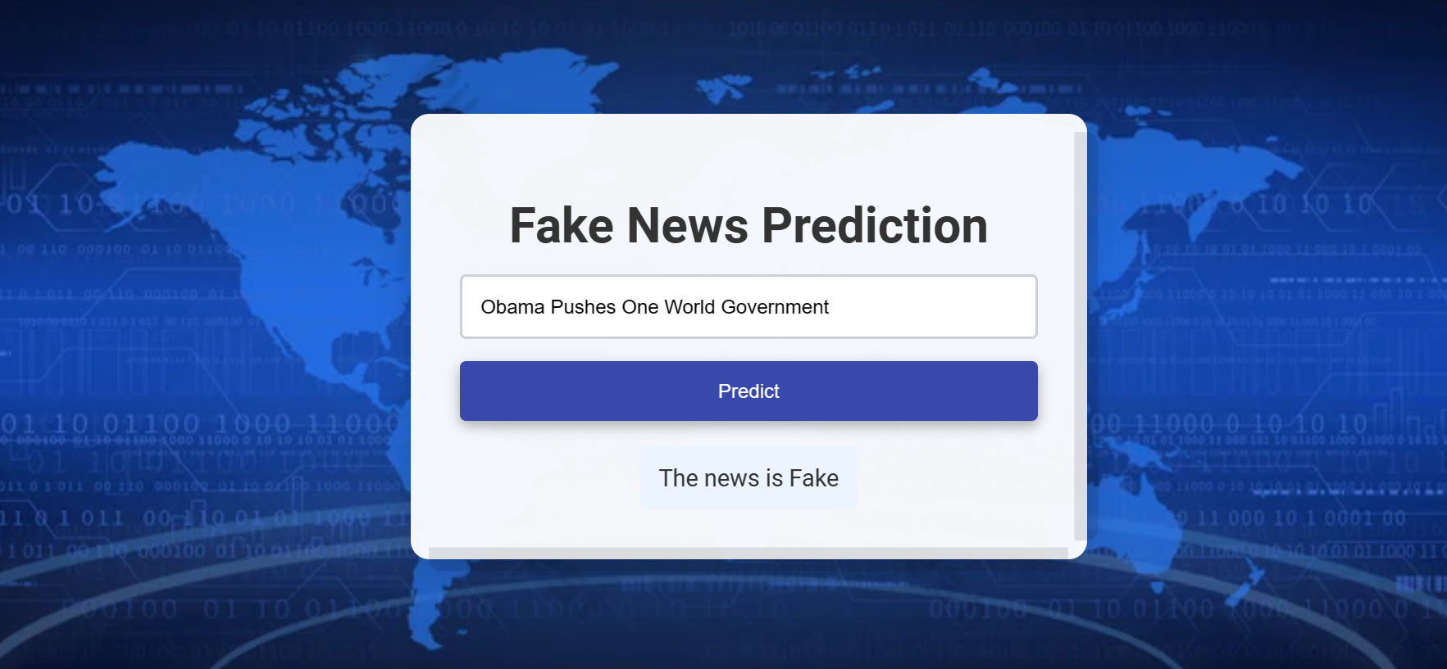

Slide 23
Demo Time!

Slide 24
References
(Bahad et al.)
]K. Shu, D. Mahudeswaran, S. Wang, D. Lee, and H. Liu, “FakeNewsNet: A Data Repository with News Content, Social Context, and Spatiotemporal Information for Studying Fake News on Social Media,” Big Data, vol. 8, no. 3, pp. 171–188, Jun. 2020, doi: https://doi.org/10.1089/big.2020.0062.
Bahad, Pritika, et al. “Fake News Detection Using Bi-Directional LSTM-Recurrent Neural Network.” Procedia Computer Science, vol. 165, 2019, pp. 74–82, https://doi.org/10.1016/j.procs.2020.01.072.

Slide 25
THANK YOU!

